Slide 1

ATLAS Underground Guides
Visit description
December 2022
EDMS: 1724179

Slide 2
Tips
Understand your public, their level of knowledge and their expectations to adapt your speech
When performing the 2 visits as a shadow guide, discuss with the guides, take information
Advice to print a schema of the accelerators, ATLAS detectors or other info as a portfolio
At the end you will create your own guiding tour content, with your experience, expertise and anecdotes
Pay attention to your time management and keep a good balance between your speech and the audience’s questions, providing sufficient time for their questions
Respect the safety rules and the overall timing

Slide 3
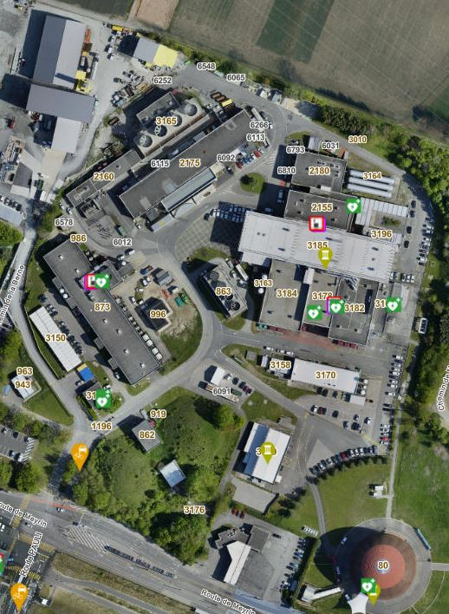
Visit step by step
Point 1
Point 1 organization
P1 is shared between ATLAS, complementary forward detectors, as well as the TI18 neutrino detector and Faser (located in the LHC tunnel far away from the interaction point), LHC Machine, SPS BA6, and IdeaSquare.
Currently, our neighbors, which will then be integrated to P1 is the HL-LHC excavation work project. The HL-LHC will increase the initial luminosity about a factor of seven, resulting in an increased number of collisions (200 collisions per beam crossing), which will enable ATLAS to spot new or rare physics processes.
LHC
SPS BA6
ATLAS
ACR
IdeaSquare

Slide 4
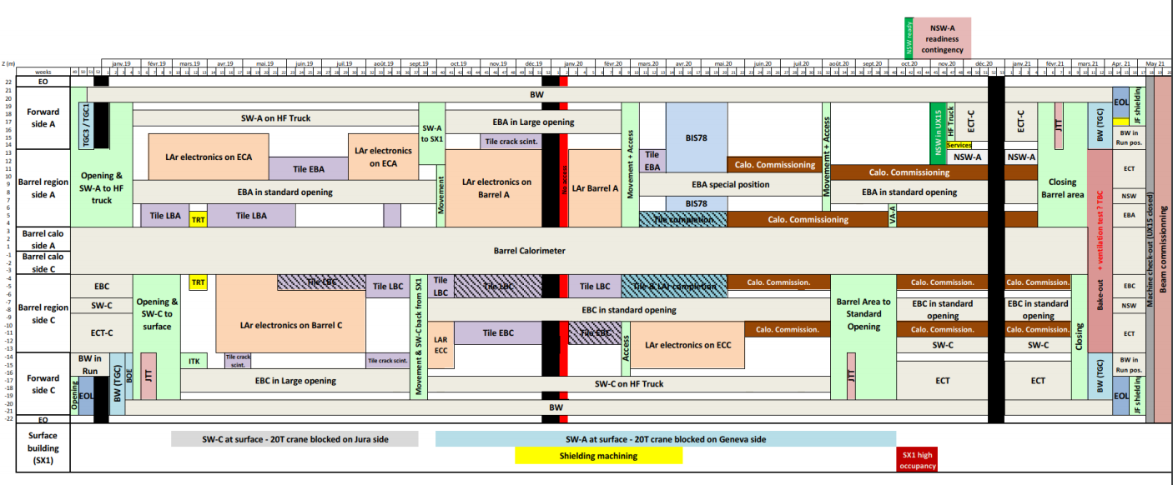
Visit step by step
LS2 Planning – Example
Courtesy of Joffrey Malaquin – ATLAS Week – 24.02.20
The LS2 planning is evolving during the time taking into consideration all activities which occurs during LS2
Maintenance and consolidation of detector elements
Installation of new electronics, trigger and detector components aimed to radiation-hardness, finer granularity and faster readout, as a first step to prepare ATLAS for the High-Luminosity LHC (HL-LHC).
While most of these new systems will be installed during the next long shutdown (LS3) – some will already see service in Run 3!

Slide 5
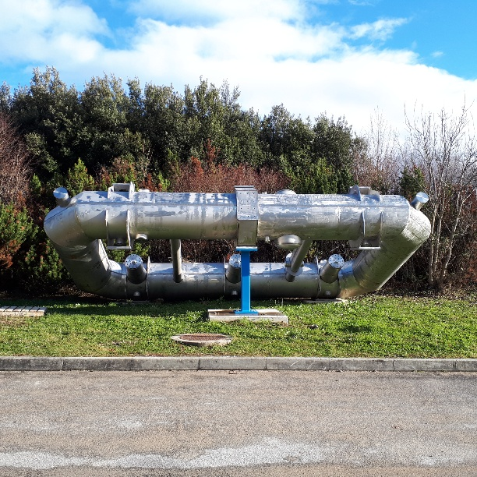
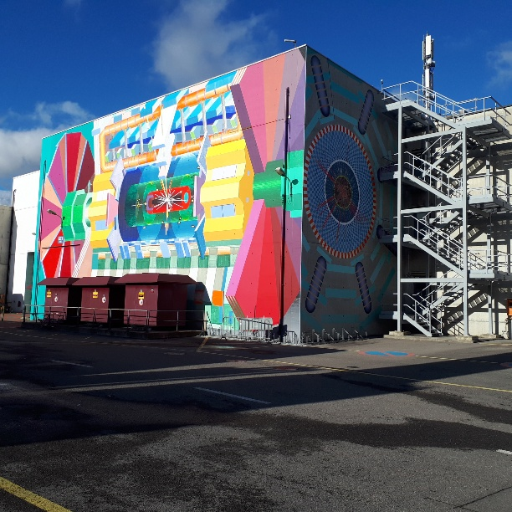
Visit step by step
Outside
B0 coil
The first fully functional prototype of the large coils that form the barrel toroid magnet of ATLAS.
Its length is almost 1/3 shorter (9 m) than the full-scale one (25 m).
The 8 superconducting coils installed in the ATLAS experimental cavern are the largest ones in the world.
Painting on the wall
Artistic view of an event recorded by ATLAS. The dimension is about 1/2 of the real detector.
ATLAS is one of the four major experiments of the Large Hadron Collider (LHC) at CERN. ATLAS looks like a gigantic microscope with a camera that can take 40 million pictures of 100 million pixels per second. It is a general-purpose detector designed to cover the widest possible range of physics at the LHC and run by an international collaboration.
It is one of the largest collaborative efforts ever attempted in science. ATLAS comprises about 3000 scientists (including students), coming from 183 institutions around the world, representing 38 countries from all continents (except Antarctica, few institutes from Africa). The collaboration counts also a lot of engineers, technicians and administrative staff.
ATLAS physicists test the predictions of the Standard Model, the theory that encapsulates our understanding about the elementary particles and their interactions. ATLAS is designed to exploit the full discovery potential and the huge range of physics opportunities that the LHC provides, pushing the frontiers of knowledge by seeking answers to fundamental questions.

Slide 6
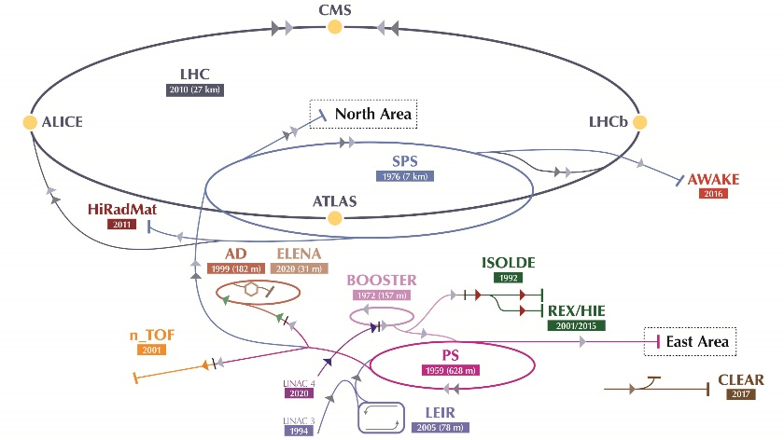
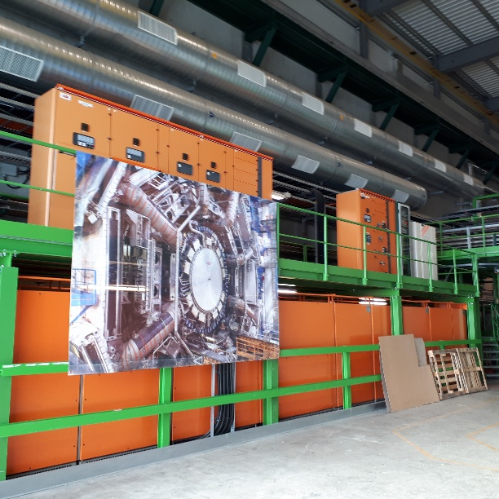
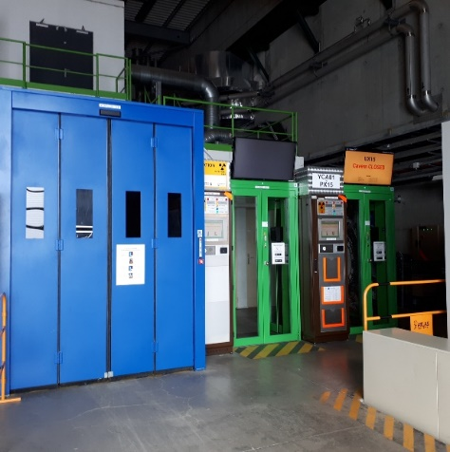
Visit step by step
SDX1
Poster of Accelerators and the 4 Large Experiments
Accelerators complex:
LINAC 4
BOOSTER
Proton Synchrotron (PS)
Super Proton Synchrotron (SPS)
Large Hadron Collider (LHC)
LHC experiments:
ATLAS (A Toroidal LHC ApparatuS)
CMS (Compact Muon Solenoid)
ALICE (A Large Ion Collider Experiment)
LHCb (Large Hadron Collider beauty)
Orange cabinets
More than 2 MW of uninterruptable electric power is available to make the operations of ATLAS as smooth as possible.
PAD and MAD – Personnel Access Device and Material Access Device
The PAD doors are the access doors for people to ATLAS underground areas:
- Green door indicates that the person accesses a not interlocked area with beam
Yellow door indicates that the person accesses an interlocked area with beam
Inside the PAD a biometry system is installed insuring to control the identity of the person entering. Then the name of the person is displayed on the access system interface.
The MAD doors are used to drop the material to be transported in the experimental cavern, as well as, for the visitors. They are always blue.

Slide 7
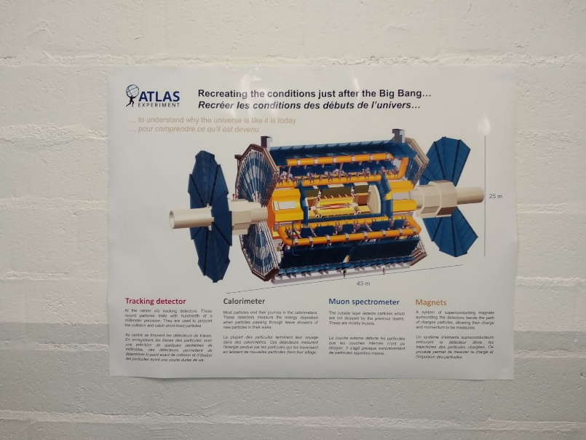
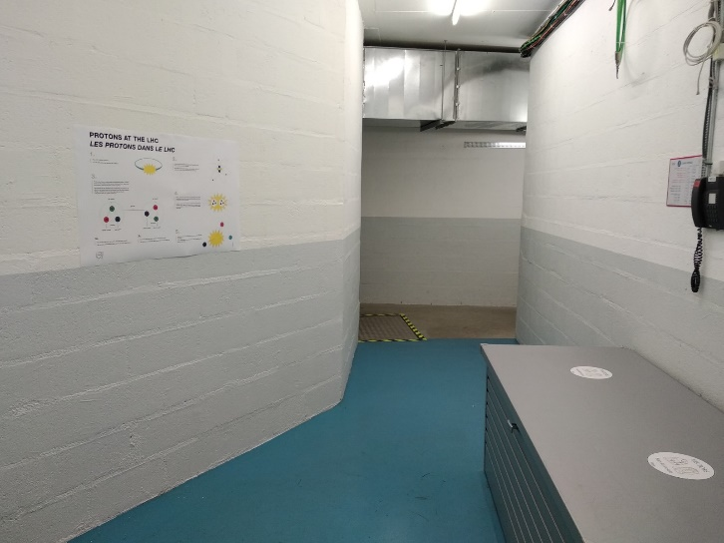
Visit step by step
SDX1
ATLAS generic info
ATLAS is the largest particle detector ever built. ATLAS stands for ‘A Toroidal LHC ApparatuS’, but it takes its name also from ATLAS, the giant of the greek mythology who had the globe on his back, because it is a giant detector (see ATLAS logo).
It is 46 m long, 26 m high, 26 m wide and weighs 7000 tonnes, like the Eiffel Tower in Paris.
Its material cost is of the order of 540 MCHF. It is financed from the funding agencies of countries participating in the collaboration, having contributions from CERN and universities.
Posters to describe the detector before going down
The ATLAS detector has a cylindrical part and two endcap parts at both extremities to provide a full coverage per collision point, so that no particles could escape undetected. Moreover, it looks like an onion in the sense that it has several layers and each layer has a very specific task in the detection of the particles.
The purpose of ATLAS is to identify the secondary particles produced during the collisions and to measure their positions in space, their charges, speeds, masses and energies. For this reason, the detector has layers of ‘sub-detectors’ for the reconstruction of the tracks, while magnets systems help to identify the charge, by separating the different particles according to it (by bending towards one or the other direction) and to allow the measurement of their momentum that depends on the mass and the speed of the particle. The higher the speed, the tracks are less curved, like a car running at high speed is more difficult to take a turn.
In particular there is a central detector made of silicon pixel and strips (like a camera) + gas tubes to measure in a magnetic field of 2 Tesla the momentum of all charged particles. Then the particles enter in an electromagnetic calorimeter made of liquid argon and lead, where the energy of electrons and photons is measured with high accuracy. The remaining particles (most of them are hadrons like the protons and the neutrons) are then absorbed by the hadronic calorimeter that measures the energy of these particles. Of the known particles only the muons and the neutrinos are able to escape the hadron calorimeter. The muons' momentum is measured by the large muon spectrometer based on toroidal magnets and three layer of precise drift chambers, the presence of neutrinos instead is measured as an imbalance of the energy in the event.

Slide 8
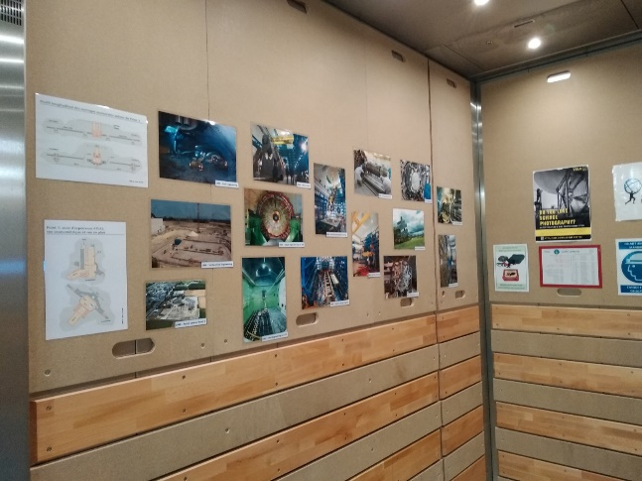
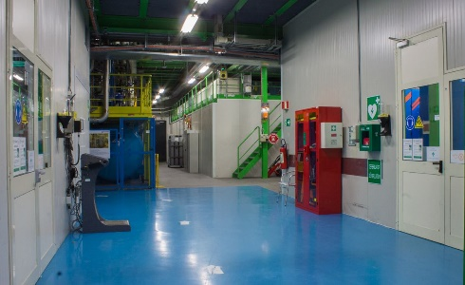
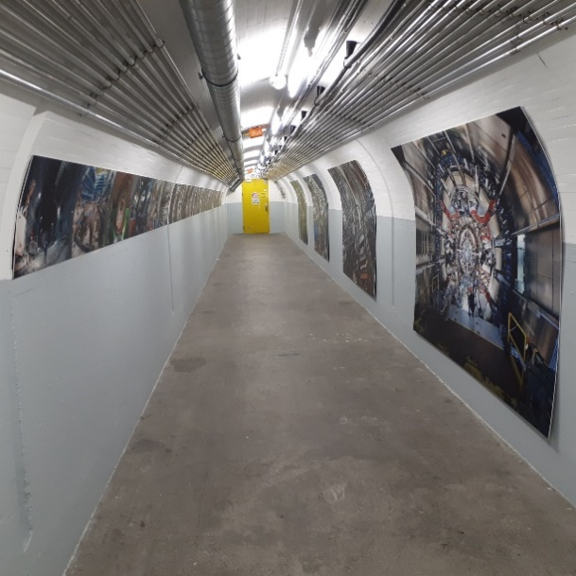
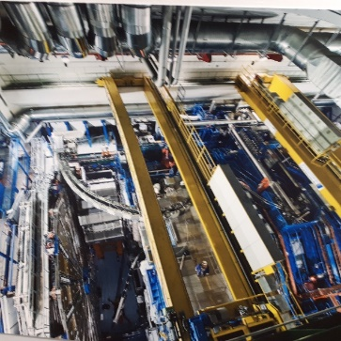
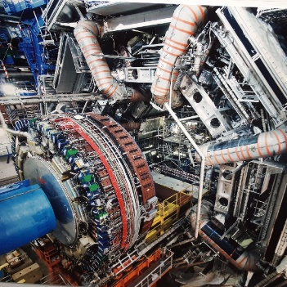
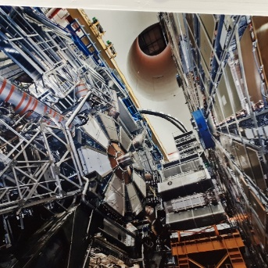
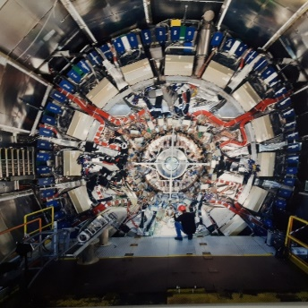
Visit step by step
USA15 – UPX14
Pictures in the lift (to be re-added)/ in front of the lift
First pictures showing the start of the excavation on a green field in 1998, the excavation of the cavern 100 m below ground, the start of the filling with detectors (2004), the barrel toroid (2006) and the last connected piece of the beam pipe (2008).
USA15
Two rack rooms in two levels house more than 200 racks. This area is accessible at any time, which is not the case for the experimental cavern, which is only accessible, when there are no particle beams, due to the high level of radiation.
In these rooms custom electronics is the back-end of the data acquisition.
Orange fibers: all the data from the detectors are transferred to the electronics via cables/fibers.
Cryogenic system: Liquid Argon for the electromagnetic calorimeter (Temperature 87 K = -185 C) and Liquid Helium for the magnets (Temperature ~3 K = -270 C)
Corridor UPX14
Also interesting here are the two events display, one with an Higgs candidate in four leptons and the other one with Jet Quenching in heavy ion collisions.
Many interesting photos of different phases of the construction.

Slide 9
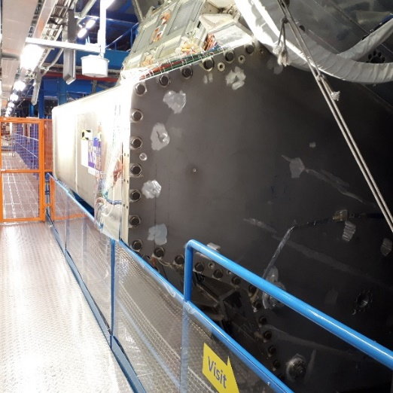
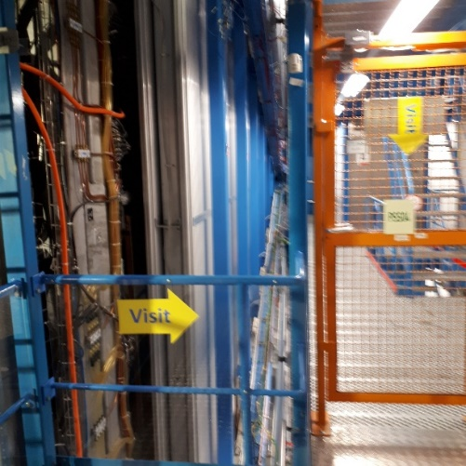
Visit step by step
UX15 – HS-US Level 4 – On the visitor platform
End Cap Toroid (ECT)
A very large cryostat that contains the eight superconducting coils of the End Cap Toroid. With the 8 toroid coils the compose the ATLAS magnets. When excited to the nominal current 20000 A are flowing (without resistance) in the superconducting coils. The high magnetic field in the Toroid volume is used to bend the trajectory of high energy muons. From the precise measurement of the trajectory and with a very precise knowledge of the magnetic field we are able to measure the momentum of 1 TeV/c muons, with a precision of ~10%. This is very important in the searches of new particles as for example new Z’ bosons that, if existing, may be the mediator of a new fundamental force.
Muon spectrometer
In the full muon spectrometer there are 354000 drift tubes. The position of each of these tubes (actually the wire in the middle of the tubes) is known with a precision of μm, within the huge volume of the ATLAS detector. To achieve this goal there is a very complicated alignment system based on rays relating the different parts of the spectrometer. Again this very high precision is needed to achieve a very high resolution in the measurement of the momentum of the muons.

Slide 10
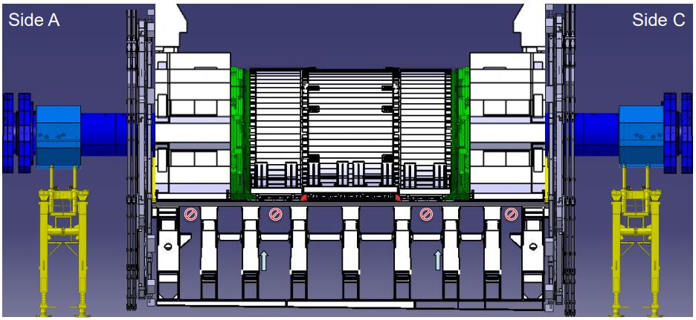
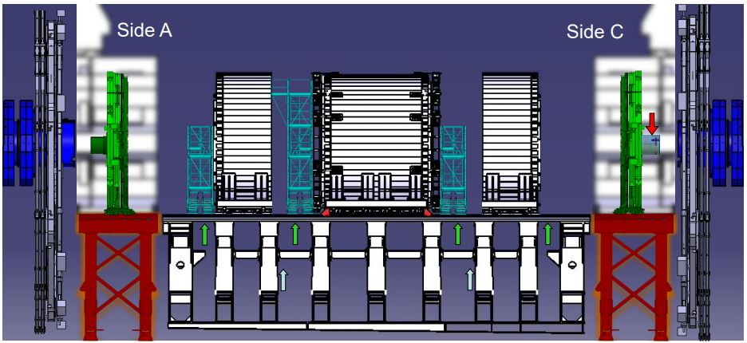
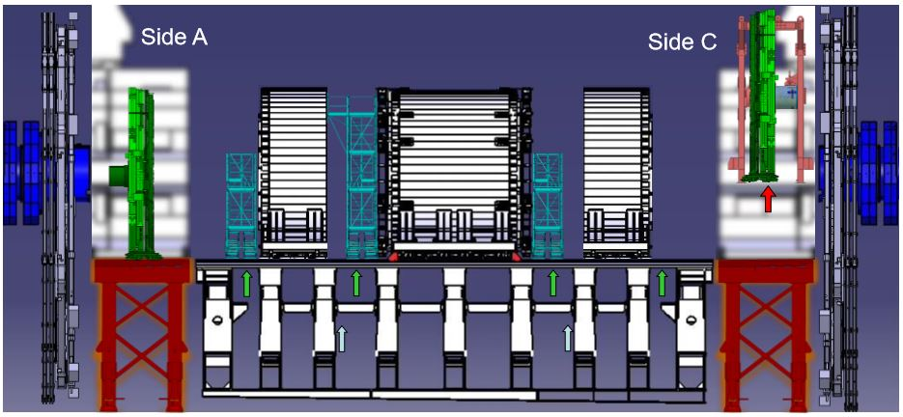
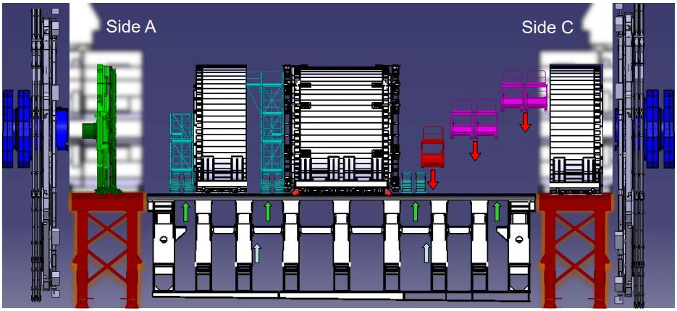
Visit step by step
UX15 – HS-US Level 4 – On the visitor platform
Selfies, questions and discussion about the LS2
It is up to the guide to decide, but a good approach is to go to see the detector first and then on the way back to stop at the various steps mentioned on the slides presented before.
The detector view can be different depending on the opening scenario.
The Long Shutdown 2 (LS2), which started in December 2018, aims to maintain, upgrade and consolidate the detectors and the accelerators for a couple of years (probably back in operation in May 2021).
Examples of detector configuration
Run Configuration
LS2
LS2
LS2

Slide 11
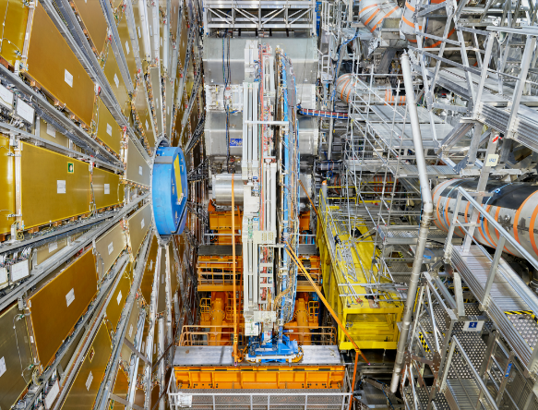
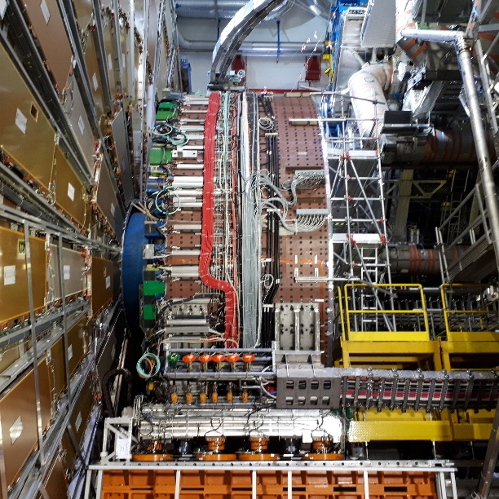
Visit step by step
UX15 – HS-US Level 4 – On the visitor platform
Additional information for the LS2:
The New Small Wheels (NSW) project (part of the Muon Spectrometer) will be the first major addition to the detector, planned for 2020. Each of the two New Small Wheels is based on two detector technologies:
the small-strip Thin Gap Chambers (sTGC) and
the Micromegas,
able to withstand the higher flux of particles expected in HL-LHC interactions and to improve the muon trigger capabilities, thanks to refined event selection.
16 new Small Monitored Drift Tubes (sMDT) chambers for tracking, providing an order of magnitude higher rate capability and their relevant Resistive Plate Chambers (RPCs) for trigger will be installed in the barrel part of the detector, aiming to improve its overall coverage.
New front-end electronics and optical-fibre cabling will enhance the Liquid Argon (LAr) calorimeter, improving the trigger resolution, by increasing the granularity by a factor of 4.
New electronics boards for trigger and data-acquisition systems will improve the overall resolution of the detector.
The coordination of the LS2 activities is very complex, as the tight installation schedules need to be combined with the sub-detector maintenance works:
the complete overhaul of the Tile Calorimeter’s cooling connectors
the repairs of the Transition Radiation Tracker (TRT), LAr and RPC systems
the completion of the ATLAS Forward Proton (AFP) system.
All the mentioned improvements aim to maximise the detector performance, taking place in parallel with the machine operation improvements. Certainly, this is a very busy period for the people who work on the detectors projects, but also for the people who analyse the data collected, during the Run 2.

Slide 12
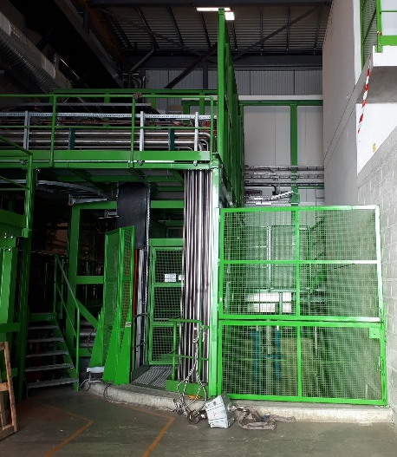
Visit step by step
SDX1
TDAQ room (in SDX1)
The events that are selected online by the first level trigger are sent to the computer farm hosted in the SDX1 room for a second screening of the event, after full reconstruction.
The 40 million events/s cannot all be stored in the computer centres, so selecting the most relevant is a must. We start with about 40 million events/s to be analysed, the first level trigger based on custom electronics is able to reduce this number to about 100 000 events in about 3 μs, based on basics quantities (energy or momentum of particles etc.)
The selected events are then fully reconstructed by a farm of computers and finally the “best” 1500 per second are recorded to be further analysed by the ATLAS Physicists around the world. Data taking efficiency of about 95%.

Slide 13
Frequently asked questions
What are the basic building blocks of matter (elementary particles)?
ATLAS studies the Standard Model particles and searches to determine if the particles we know are indeed elementary or if they are composed of other more fundamental ones.
How the particles interact?
The Standard Model describes how the particles interact. There are four interactions/forces: gravity, electromagnetic, strong and weak. Possible discoveries could validate theories, according to which the forces unify at very high energies.
What happened to antimatter?
The scientists believe that at the very early universe there was the same amount of matter and antimatter, but thanks to a mechanism the matter became predominant. During the LHC collisions there is the production of both matter and antimatter and the physicists try to understand this imbalance.
What is the “dark matter”?
The visible matter is only the 4% of our universe. There is 73% of dark energy and 23% of dark matter. We know the existence of the dark matter, due to the faster rotation of the galaxies that it causes, but we do not know its exact nature, as there are no any known particles with these properties. It is possible to discover it during the particle collisions, when the energy is transformed into matter (E=mc²).
What was the early universe like and what is its evolution?
The LHC proton-proton and lead-lead collisions could recreate the conditions immediately after the Big Bang, when the energies and the temperatures were extremely high, allowing ATLAS to study how the particles acquired their masses.
What about the gravity?
The gravitational force is extremely weak, when compared to the other forces, which makes the unification effort very challenging. Extra dimensions models have the ambition to explain this difference.

Slide 14
Frequently asked questions
How do particles acquire mass? Why do they have different masses?
There was always the open question about how the particles acquired their masses at the very early universe, why particles have different masses and why the protons are 2000 times heavier compared to electrons. To answer these questions, three teams of theorists: Robert Brout and François Englert; Peter Higgs; Gerald Guralnik, Carl Hagen, and Tom Kibble independently proposed a model, known as the Brout-Englert-Higgs (BEH) mechanism.
The BEH mechanism required the presence of a new field in the universe, which gave mass to some of the particles (photons are massless). The existence of this field can be verified by the discovery of its associated particle - the Higgs boson. The stronger a particle interacts with the Higgs field, more massive it is.
In July 2012, the ATLAS and CMS experiments jointly announced that they had independently observed a new particle, consistent with the Higgs boson, in the mass region of 126 GeV. A year later, the Nobel Prize in Physics was awarded to the theorists François Englert and Peter Higgs "for the theoretical discovery of a mechanism that contributes to our understanding of the origin of mass of subatomic particles, and which recently was confirmed through the discovery of the predicted fundamental particle, by the ATLAS and CMS experiments at CERN's Large Hadron Collider".
These studies can lead to important discoveries, such us physics beyond the Standard Model and the development of new theories that could potentially better describe our universe. ATLAS has the ambition to take experimental physics into unexplored territories (new processes and particles).

Slide 15
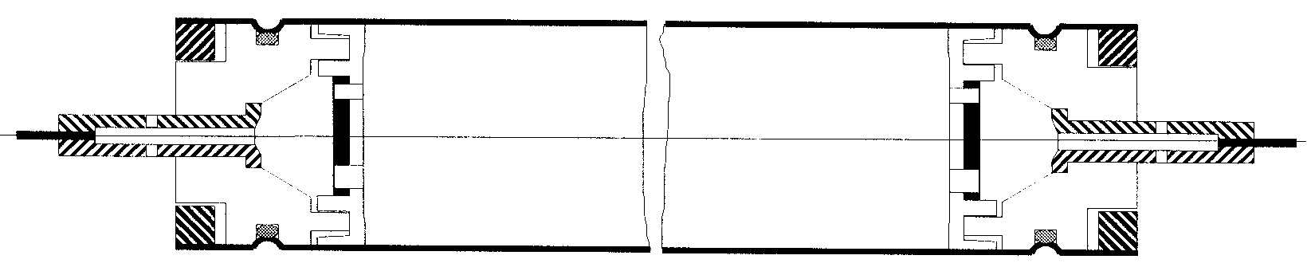
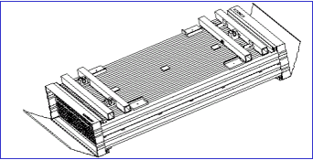
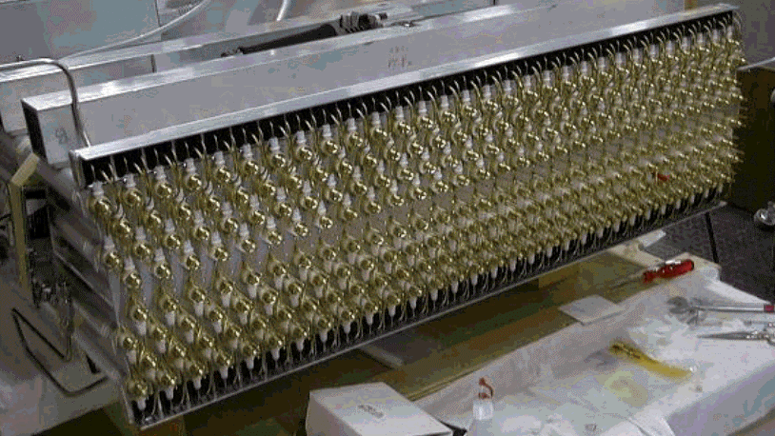
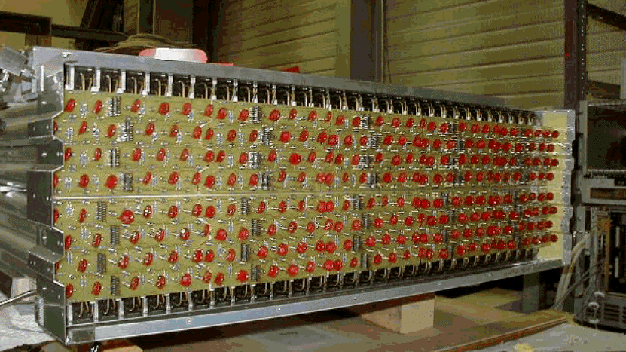
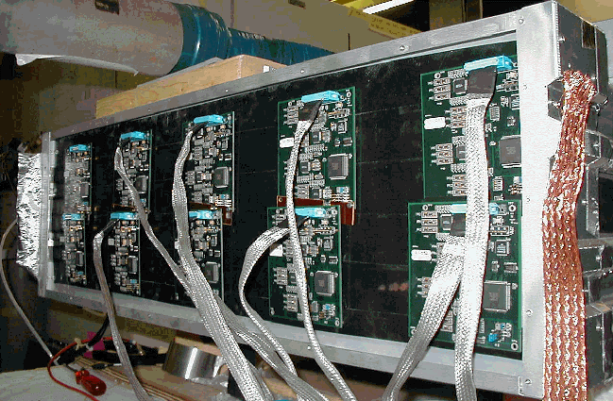
Additional information
Muon Drift Tube (MDT)
The basic detection element of the MDT chambers is a precision aluminum drift tube of 30 mm diameter (cathode) and 400 μm wall thickness, with a 50 μm diameter gold-plated W-Re wire (anode). The single-wire resolution is typically 80 μm.
To improve the spatial resolution at 35 μm and the efficiency of a chamber beyond the single-wire limit, the MDT chambers consist of two multilayers of 3 or 4 layers each that are glued on either side of a support structure.
Each chamber is equipped with a gas system and electronics. There is a parallel gas supply for each tube and multiplayer, and the gas flow is 35 Nl/h (1 volume change per day). The gas is the nominal MDT gas of Ar (93%)/CO2 (7%) at an absolute pressure of 3 bar.
A high voltage of 3080 V is applied between the anode wire and the cathode.
Each drift tube is read out by an amplifier-shaper-discriminator circuit.

Slide 16
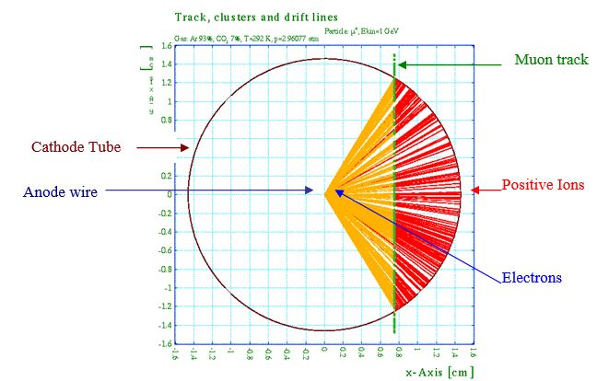
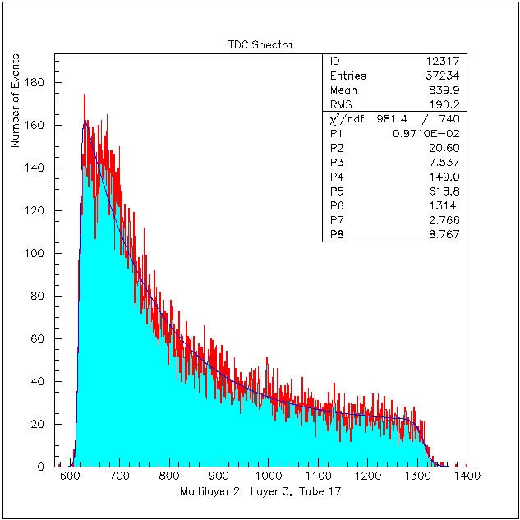
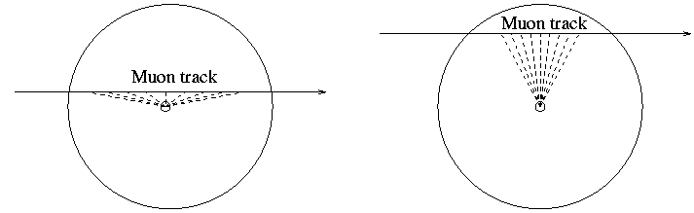
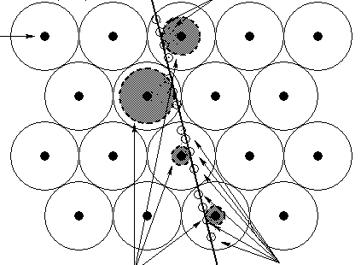
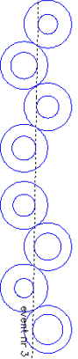
Additional information
Muon Drift Tube (MDT)
If a charged particle traverses the tube, electron-ion pairs are created along its path. Under the inﬂuence of the electric ﬁeld the primary electrons (from the ionization) drift radially towards the anode wire. Drifting in the high electrical ﬁeld, close to the wire, they initiate an avalanche and consequently the initial charge is multiplied by a factor, which depends on the gas composition and the operating conditions. In a similar way the ions drift towards the cathode (tube wall), inducing a signal, which is read-out by the electronics.
The drift time of the primary electrons towards the anode wire depends on the geometry of the drift tubes, the gas composition and pressure, as well as on operational and environmental parameters (HV, T, B). To determine the distance of a track from the anode wire, the drift times of the electrons have to be measured. The signal of the drift tube created by the arrival of the primary electrons at the wire is used to stop the time measurement (TDC), while the start is provided by the trigger chamber (RPC or TGC).
The conversion of the measured drift time to a radius, is based to a space-to-drift time (rt) relation, derived by integration of the drift time spectrum, from the measured particle tracks data, or from simulation.
The ATLAS MDT chambers were designed to cope with counting rates up to 300 kHz per tube, corresponding to an occupancy of about 20%. With the planned LHC luminosity upgrade, the chambers will exceed these counting rates, in the forward regions of the spectrometer. For this reason two approaches will be followed.
Same technology (MDT), reducing the tube diameter to the half (15 mm), keeping the other operation parameters (gas mixture, gas pressure and gas gain) unchanged while the second is to use a
New chamber technology (Micromegas).

Slide 17
Useful links
ATLAS.cern
ATLAS LS2 Shut down
LHC.cern
ATLAS TDR
LHC TDR
The ATLAS Experiment at the CERN Large Hadron Collider, 2008 JINST 3 S08003
LHC Machine, 2008, JINST 3 S08001
Questions about ATLAS outreach:
atlas-outreach-coordination@cern.ch

Slide 18


